Slide 1


Western Power Hack-a-Gig
Team UnicorNN

Slide 2
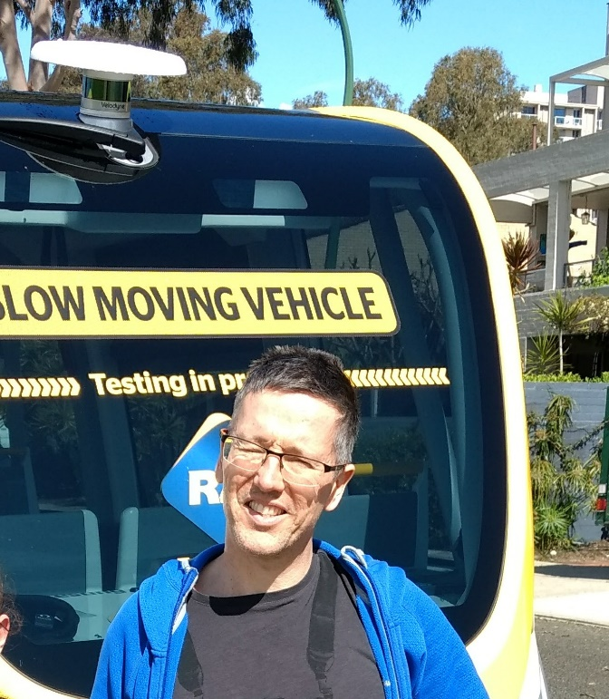

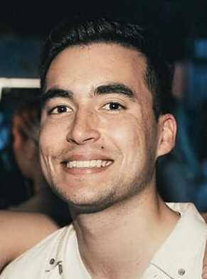
Team UnicorNN
Sofia Sibanic
Electrical Engineer (Western Power) looking to broaden her skillset and apply learnings from fast.ai.
Adrian Goldberg
Geophysicist (Santos) with >10 years programming and ~2 years deep learning experience.
Jordan Pratt
Data Strategy Analyst (Western Power) looking to expand personal skills.

Slide 3
Our Overall Approach
Initial idea was to split the team in half and share learnings
Team members choose what they are interested in
We undertook both challenges, but only Part A of Challenge 2
Learnings captured on GitHub repository wiki
Queries and tasks managed via team Slack channel

Slide 4
Challenge 1
Smart Meter Data

Slide 5
Challenge 1 – Smart Meter Data
The Challenge
Approach
Findings
Key Learnings

Slide 6
The Challenge
<Challenge Summary>
Notes:
Initially started on own but requested to join team UnicorNN
Createing a clean dataset took 80% of time for this project

Slide 7
Our approach
Adrian interested in time series problems.
Understanding – explored problem, objectives and recommendations.
Research – literature and open source code for similar datasets
Data – created clean test, and train datasets
Selected RMSE metric as metric for all forecasts
Forecasting – tried 9 model types, simple through complex
Clustering – explored several methods – chose a novel approach.
Notes:
Initially started on own but requested to join team UnicorNN
Createing a clean dataset took 80% of time for this project

Slide 8
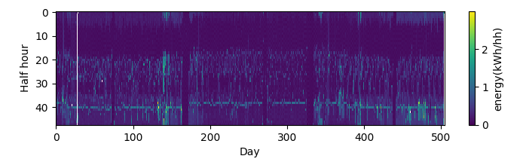
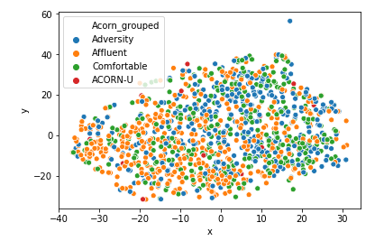
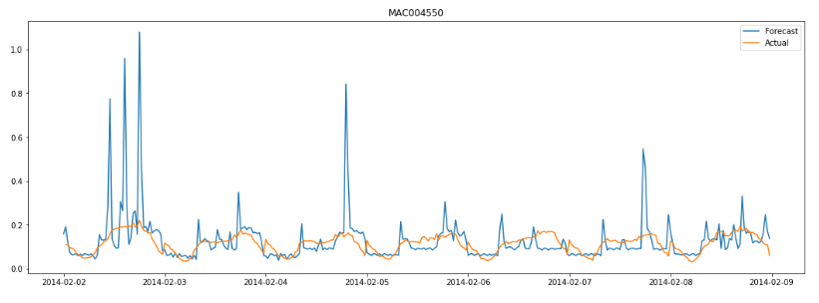
We found…
Inconsistencies in the acquisition data
A relationship between Customer groups and
consumption patterns
Several methods to reasonably
accurately forecast 7 days ahead
Notes:
Data inconsistencies: gaps, varying start/stop dates for smart-meter acquisition.

Slide 9
We learnt…
Use a sample dataset first – then run on full dataset
LightGBM is robust, quick to run - good forecasting performance.
LSTM for forecasting half hourly data gives good results but is really slow.
Converting the energy consumption curves to images and using a Neural Network to cluster is relatively fast and is worth further exploration
Notes:
- break the data down into a manageable size as quickly as possible -
– build models on this, then run the workflows on the larger dataset.
Clustering large time series datasets using kNN and dynamic time warping
is very compute intensive

Slide 10
Challenge 2
Photovoltaic generation
PART A - Detection

Slide 11
Challenge 2 – Photovoltaic Generation
The Challenge
Approach
Findings
Key Learnings

Slide 12
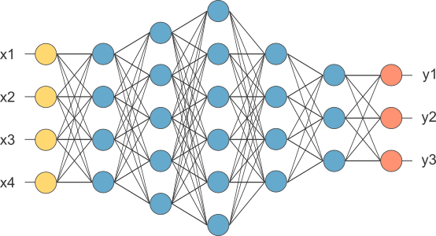
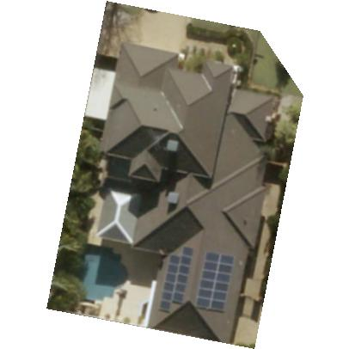
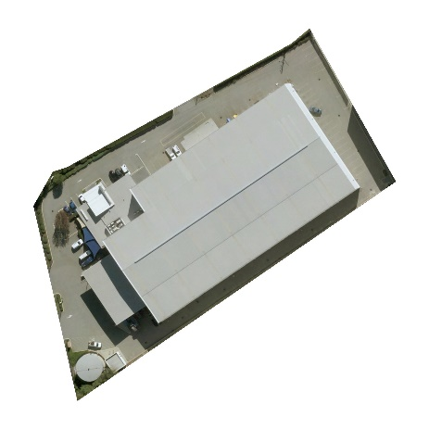
The Challenge (Part A)
Input
Model
Output
Aerial imagery
Metadata
Image recognition

Slide 13
Overview
1
Retrieve Data
2
3
Explore Data
Prepare Data
4
Develop model
5
Assess performance
6
Submit Model
Define requirements
Understand task
Analyse data
Form an approach
Consider limitations
Determine deliverables
Follow to-do list (right)
Document learnings
Share insights

Slide 14
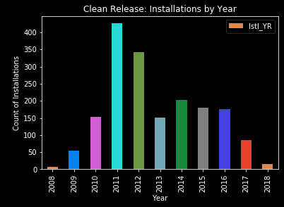
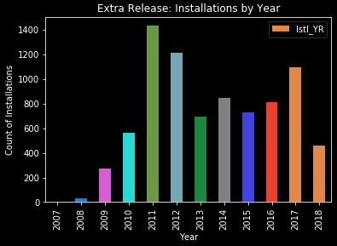
Approach
First, understand the data
What is provided?
~16,500 total images
What does it represent?
Installations from 2007-2018
Mostly 2011/2012 installations

Slide 15
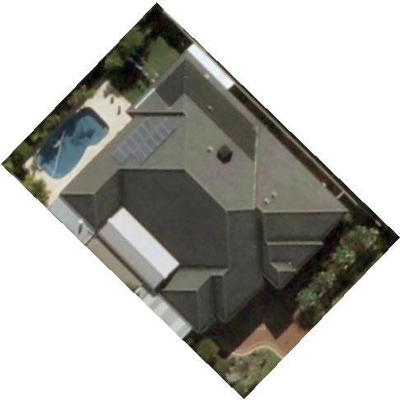
Approach
Understand Data
How does it look?
Mostly square
(400 x 400 pixels – good!)

Slide 16
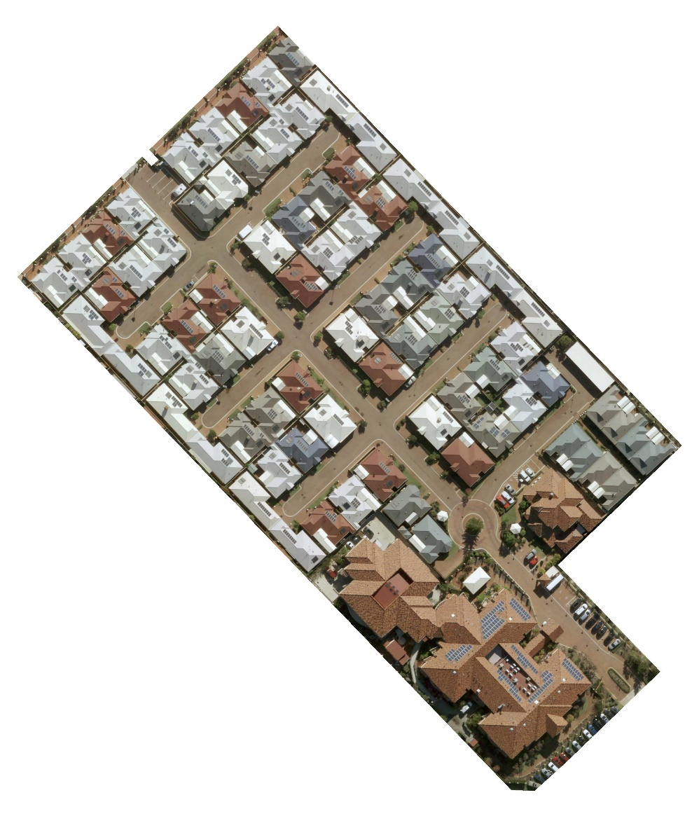
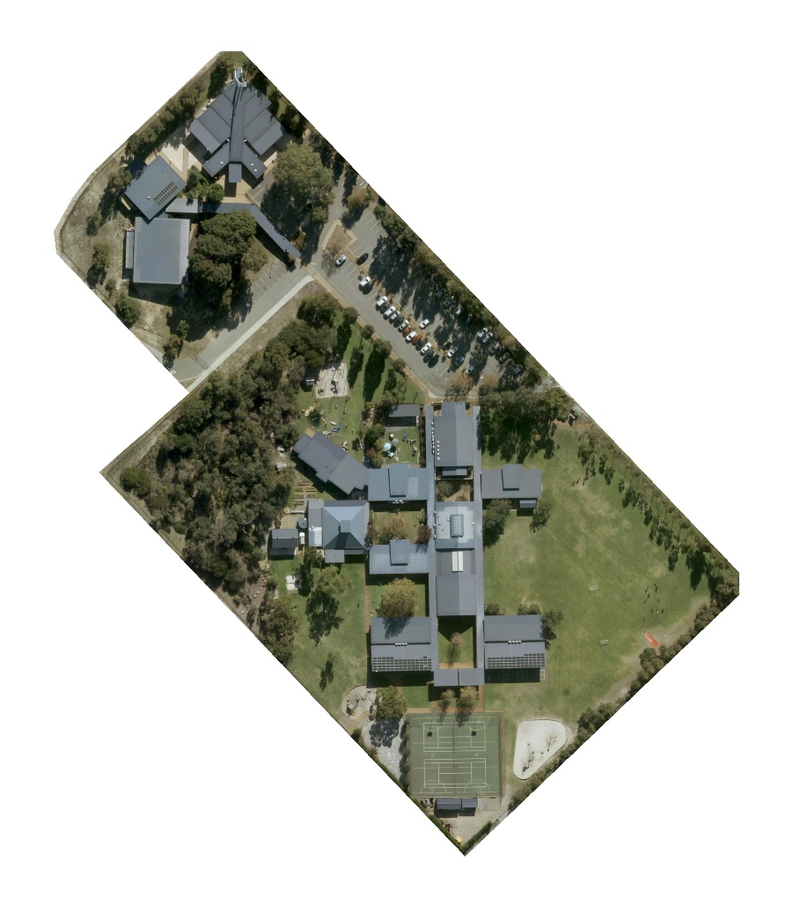
Approach
Some outliers
Rectangular, large, multi-residential
3000x3500 px
3500x4000 px

Slide 17
Approach
What may create false positives?
Air-conditioning units | Vehicles | Drawn-out shadows
Pools | Pergolas | Roof-tie structures
Elevated roof sections | Solahart water-heating units | Commercial ducting
Commercial walkways | Parking spaces and driveways | Water tanks
Tarps | Trampolines
What may create false negatives?
Rectangular images | Objects covering panels | Poorly angled panels
Lack of visible panel edges | Shade (unlikely)

Slide 18
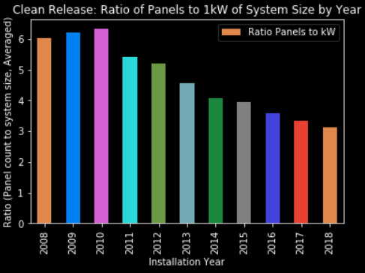
Approach
Exponential system size increase based on annualised data
Increased system sizes partly attributable to panel efficiency gains (W/m²)
Understand Data

Slide 19
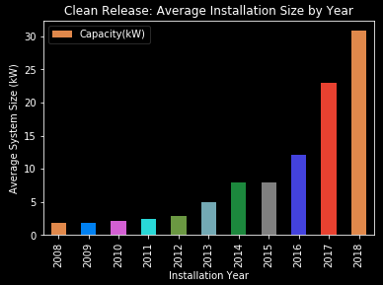
Approach
Understand Data – what was odd?
Normal system size is around 5kW
Why is it >20kW in 2017/18?
Sample bias?
Unusual for
residential!

Slide 20
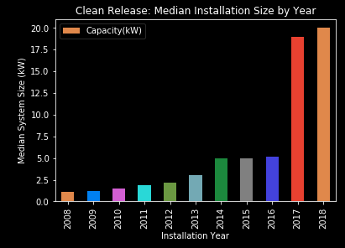
Approach
Using median instead of mean, sample bias is evident

Slide 21
Approach
What may create false negatives?
Rectangular images | Objects covering panels | Poorly angled panels
Lack of visible panel edges | Shade (unlikely)

Slide 22
The Model
Convolutional Neural Net (CNN) model
Leverages the Fast.AI wrapper on top of PyTorch
Specifies:
Data set to utilise
Functions to split source data into a training & validation set
Functions to import image meta-data
Learning rate specification and annealing
Data augmentation
Result accuracy based on confusion matrix output

Slide 23
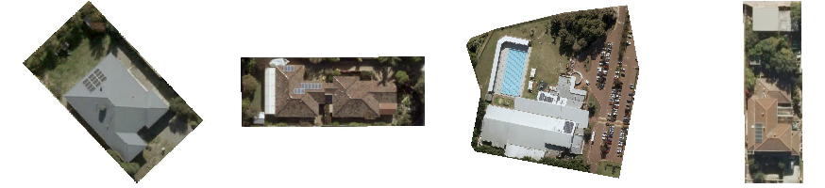
We found…
Training the model – first try – 86.4% accuracy
False negatives generally occurred where panel edges were not visible

Slide 24
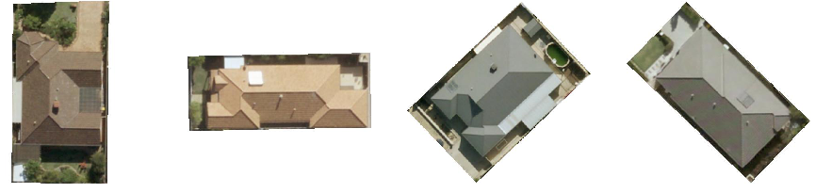
We found…
False positives generally occurred on grid-like structures and solar water heating systems

Slide 25
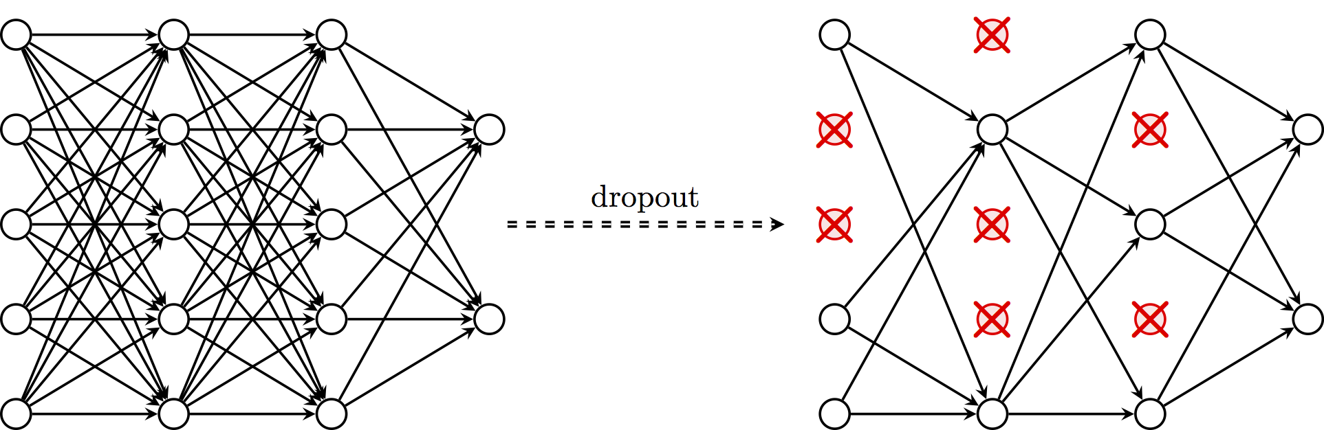
What didn’t work...
We tried different techniques to improve generalisation
Dropout – Take a segment of model information, throw it away

Slide 26
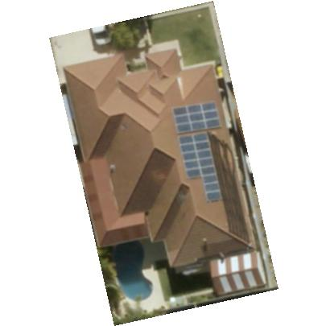
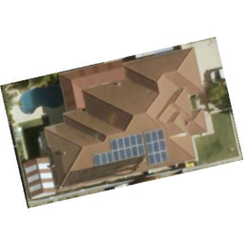
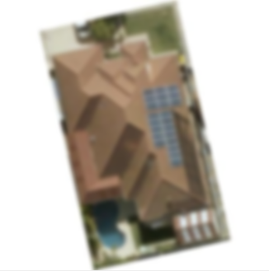
What didn’t work...
We tried different techniques to improve generalisation
Data augmentation – Change input data in various ways
Original Rotated Blurred

Slide 27
We learned…
Following the Fast.AI principles yields generally accurate results
Data augmentation should be kept to a minimum
Randomising the training set helps with consistency
More complex Neural Net models didn’t improve accuracy
Accuracy with different approaches ranged from 86.4% to 97.9%

Slide 28
What worked?
Dropout
No dropout results in rapid overfitting – not recommended
Default dropout of 25% (first dropout layer) and 50% (second dropout layer) in the resnet34 model worked well

Slide 29
Challenge 2
Photovoltaic generation
PART B - SIZING

Slide 30
Overview
Part B continues from Part A code
PV image Metadata is accessible in the Jupyter Notebook

Slide 31
Thank you for your attention.
Team UnicorNN

